Slide 1
Social Network Analysis – Network Dynamics
Viral Marketing

Slide 2
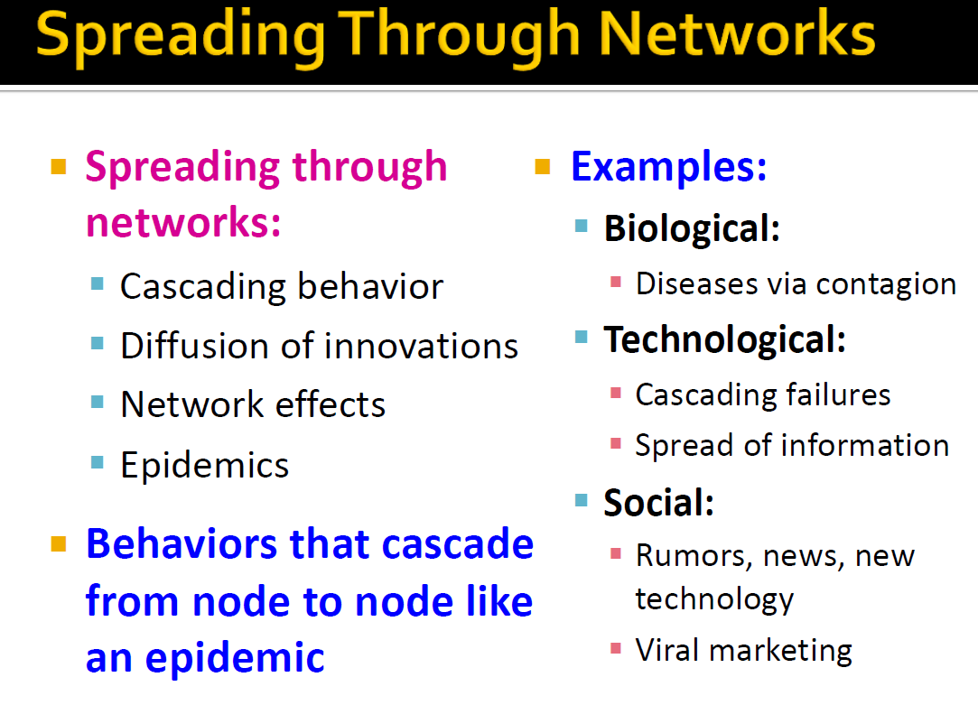

Slide 3
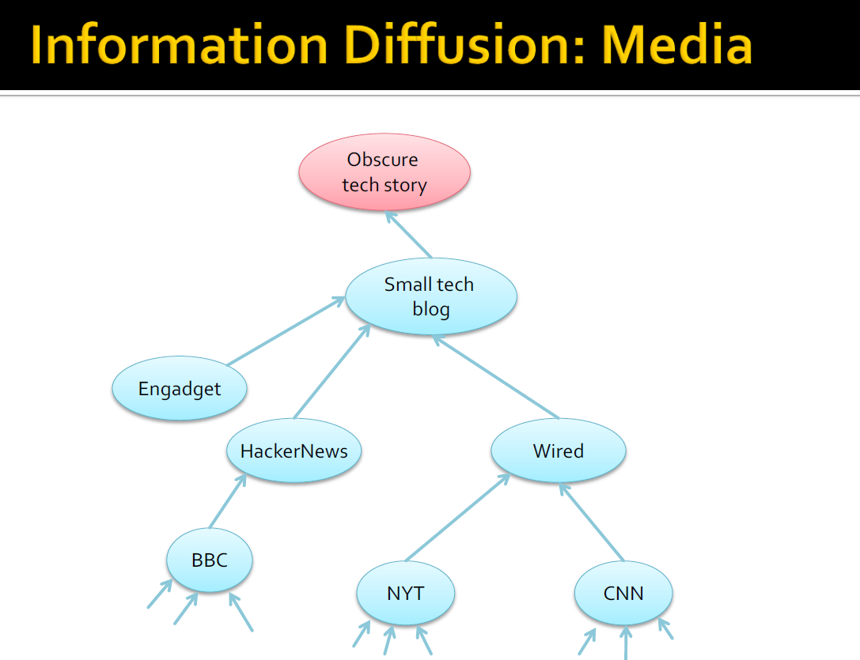

Slide 4
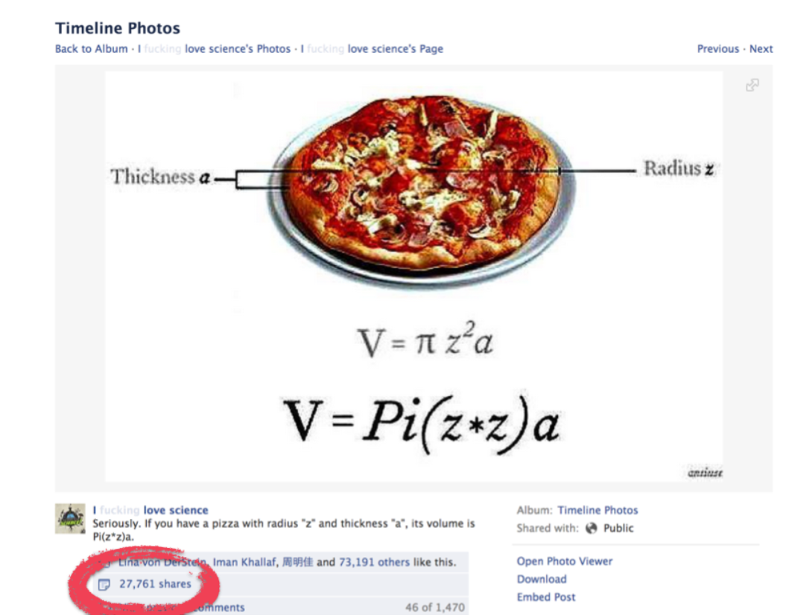
Social Media Posts

Slide 5
Network Effect
Application – Viral Marketing
Information Cascade
Cascading Behavior in Networks
Epidemics

Slide 6
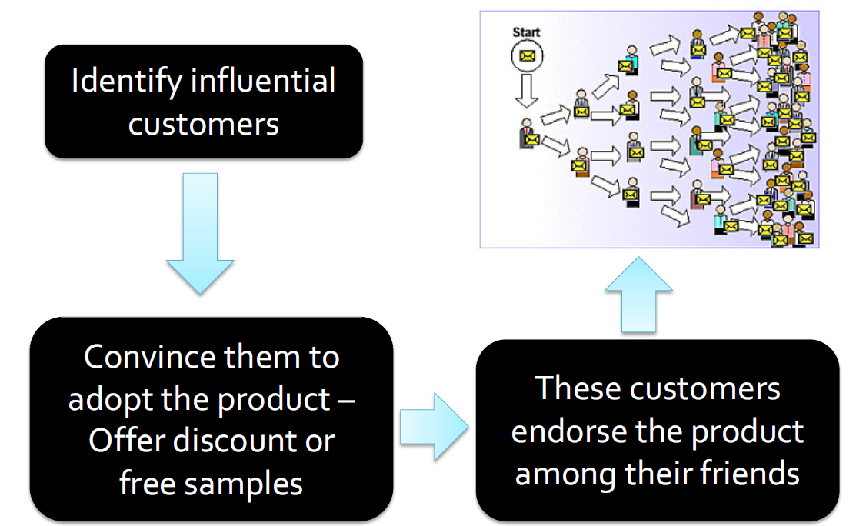
Viral Marketing

Slide 7
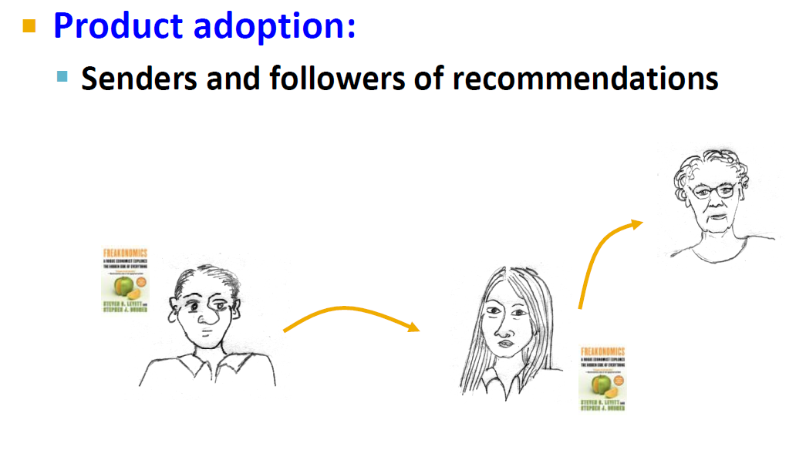
Diffusion in Viral Marketing

Slide 8
Viral Marketing – Useful?
We are more influenced by our friends than strangers
68% of consumers consult friends and family before purchasing home electronics

Slide 9

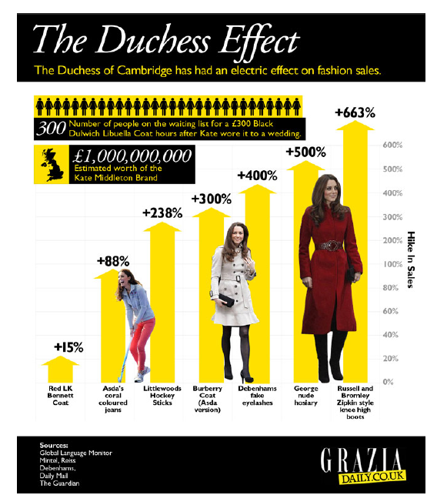
Kate Middleton Effect
According
to Newsweek, "The
Kate Effect may be
worth £1 billion to the
UK fashion industry."

Slide 10
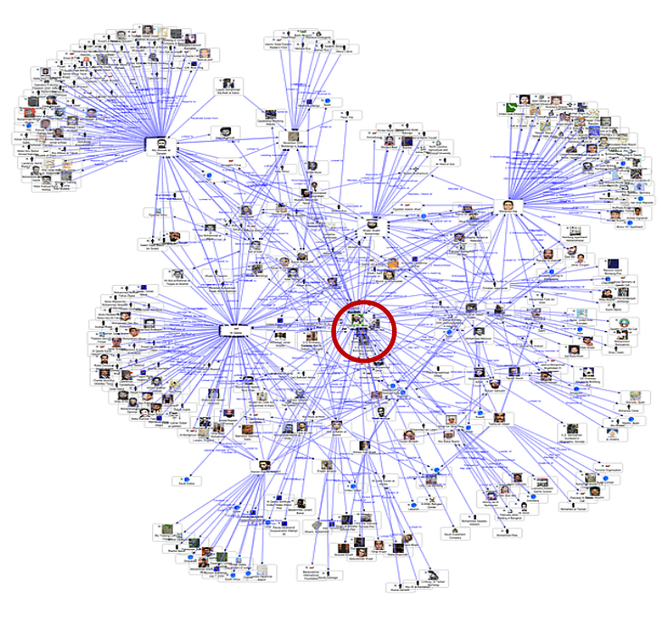
How to find Kate?
Influential persons have many friends.

Slide 11
Maximizing the Spread of Influence through a Social Network
Authors: David Kempe, Jon Kleinberg, Éva Tardos
KDD 2003

Slide 12
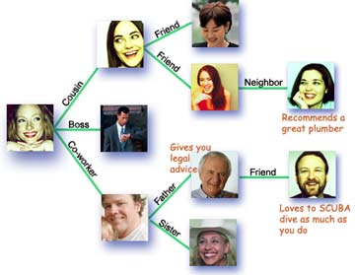
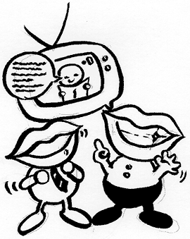
Social Network and Spread of Influence
Social network plays a fundamental role as a medium for the spread of INFLUENCE among its members
Opinions, ideas, information, innovation…
Direct Marketing takes the “word-of-mouth” effects to significantly increase profits (Gmail, Tupperware popularization, Microsoft Origami …)

Slide 13
Problem Setting
Given
a limited budget B for initial advertising (e.g. give away free samples of product)
estimates for influence between individuals
Goal
trigger a large cascade of influence (e.g. further adoptions of a product)
Question
Which set of individuals should B target at?
Application besides product marketing
spread an innovation
Notes:
if we can try to convince a subset of individuals to adopt a new
product or innovation
But how should we choose the few key individuals to use for seeding this process?
Which blogs should one read to be most up to date?

Slide 14
What we need
Form models of influence in social networks.
Obtain data about particular network (to estimate inter-personal influence).
Devise algorithm to maximize spread of influence.

Slide 15
Outline
Models of influence
Linear Threshold
Independent Cascade
Influence maximization problem
Algorithm

Slide 16
Outline
Models of influence
Linear Threshold
Independent Cascade
Influence maximization problem
Algorithm

Slide 17
Models of Influence
First mathematical models
[Schelling '70/'78, Granovetter '78]
Large body of subsequent work:
[Rogers '95, Valente '95, Wasserman/Faust '94]
Two basic classes of diffusion models: threshold and cascade
General operational view:
A social network is represented as a directed graph, with each person (customer) as a node
Nodes start either active or inactive
An active node may trigger activation of neighboring nodes
Monotonicity assumption: active nodes never deactivate
Notes:
we focus on more operational models from mathematical sociology [15, 28] and interacting particle systems
[11, 17] that explicitly represent the step-by-step dynamics of adoption.
Assumption: node can switch to active from inactive, but does not switch in the other direction

Slide 18
Outline
Models of influence
Linear Threshold
Independent Cascade
Influence maximization problem
Algorithm

Slide 19
Linear Threshold Model
A node v has random threshold θ_{v} ~ U[0,1]
A node v is influenced by each neighbor w according to a weight b_{vw} such that
A node v becomes active when at least
(weighted) θ_{v} fraction of its neighbors are active
Notes:
Given a random choice of thresholds, and an initial set of
active nodes A0 (with all other nodes inactive), the diffusion process
unfolds deterministically in discrete steps: in step t, all nodes
that were active in step t-1 remain active, and we activate any
node v for which the total weight of its active neighbors is at least
Theta(v)

Slide 20
Example
Inactive Node
z
y
0.6
Active Node
0.3
0.2
0.2
Threshold
x
Active neighbors
0.1
0.4
U
0.5
0.3
Stop!
0.2
w
0.5
v

Slide 21
Outline
Models of influence
Linear Threshold
Independent Cascade
Influence maximization problem
Algorithm

Slide 22
Independent Cascade Model
When node v becomes active, it has a single chance of activating each currently inactive neighbor w.
The activation attempt succeeds with probability p_{vw} .
Does scheduling matter? No
If 𝒖, 𝒗 are both active at the same time, it doesn’t matter which tries to activate 𝒘 first
But the time moves in discrete steps
Notes:
We again start with an initial set of active nodes A0, and the process unfolds in discrete steps according to
the following randomized rule. When node v first becomes active
in step t, it is given a single chance to activate each currently inactive
neighbor w; it succeeds with a probability pv;w —a parameter
of the system — independently of the history thus far. (If w has
multiple newly activated neighbors, their attempts are sequenced in
an arbitrary order.) If v succeeds, then w will become active in step
t+1; but whether or not v succeeds, it cannot make any further attempts
to activate w in subsequent rounds. Again, the process runs
until no more activations are possible.

Slide 23

Example
z
0.6
y
Inactive Node
0.3
0.2
0.2
Active Node
X
U
Newly active
node
0.1
0.4
Successful
attempt
0.5
0.3
0.2
Unsuccessful
attempt
w
0.5
v
Stop!

Slide 24
Outline
Models of influence
Linear Threshold
Independent Cascade
Influence maximization problem
Algorithm

Slide 25
Influence Maximization Problem
Influence of node set S: f(S)
expected number of active nodes at the end, if set S is the initial active set
Problem:
Given a parameter k (budget), find a k-node set S to maximize f(S)
Constrained optimization problem with f(S) as the objective function
Notes:
the influence of a set of nodes A: the expected number of active nodes at the end of the process.

Slide 26
Outline
Models of influence
Linear Threshold
Independent Cascade
Influence maximization problem
Algorithm

Slide 27
f(S): properties
Non-negative (obviously)
Monotone: (activating more nodes doesn’t hurt)
f preserves the order
Submodular: (activating each additional node helps less)
Let N be a finite set
A set function is submodular iff
Notes:
A function f maps a finite ground set U to non-negative real numbers, and satisfies a natural “diminishing returns” property, then f is a submodular function.
Diminishing returns property:
The marginal gain from adding an element to a set S is at least as high as the marginal gain from adding the same element to a superset of S.

Slide 28
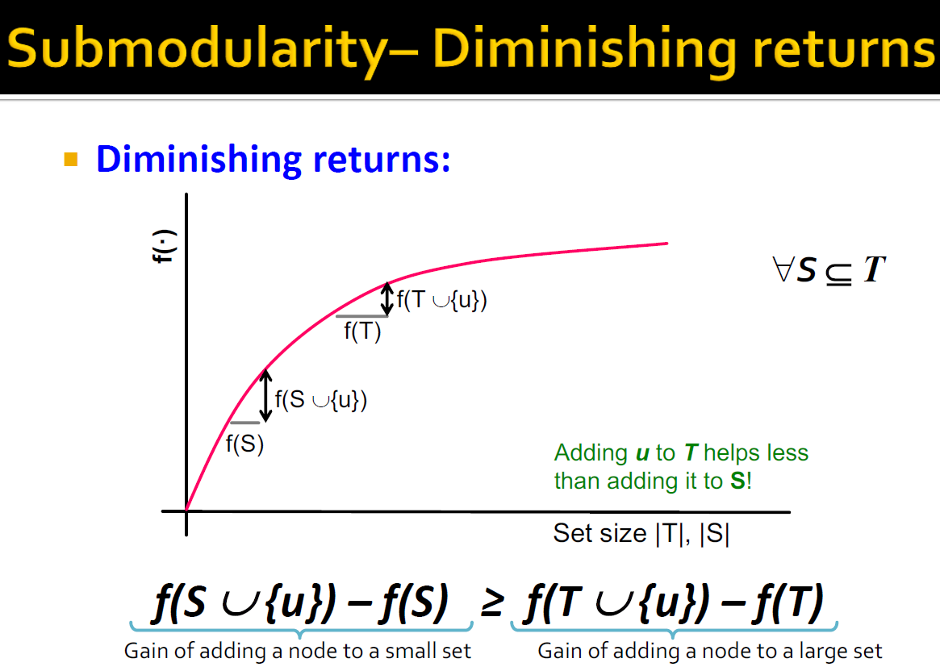
(A submodular set function (also known as a submodular function) is a set function whose value, informally, has the property that the difference in the incremental value of the function that a single element makes when added to an input set decreases as
the size of the input set increases. Submodular functions have a natural diminishing returns property)

Slide 29
Bad News
For a submodular function f, if f only takes non-negative value, and is monotone, finding a k-element set S for which f(S) is maximized is an NP-hard optimization problem
It is NP-hard to determine the optimum for influence maximization for both independent cascade model and linear threshold model.
Show that finding most influential set is at least as hard as a set cover problem
Notes:
Known results:
For a submodular function f, if f only takes non-negative value, and is monotone.
Finding a k-element set S for which f(S) is maximized is an NP-hard optimization problem[GFN77, NWF78].

Slide 30
Good News
We can use Greedy Hill Climbing Algorithm!
Start with an empty set S
For k iterations:
Add node v to S that maximizes f(S +v) - f(S).
How good (bad) it is?
Theorem: The greedy algorithm is a (1 – 1/e) approximation.
The resulting set S activates at least (1- 1/e) > 63% of the number of nodes that any size-k set S could activate.
Notes:
The algorithm that achieves this performance guarantee is a natural greedy hill-climbing strategy
selecting elements one at a time, each time choosing an element that provides
the largest marginal increase in the function value.
f(S) >= (1-1/e) f(S*)
This algorithm approximate the optimum within a factor of (1-1/e) ( where e is the base of the natural logarithm).

Slide 31
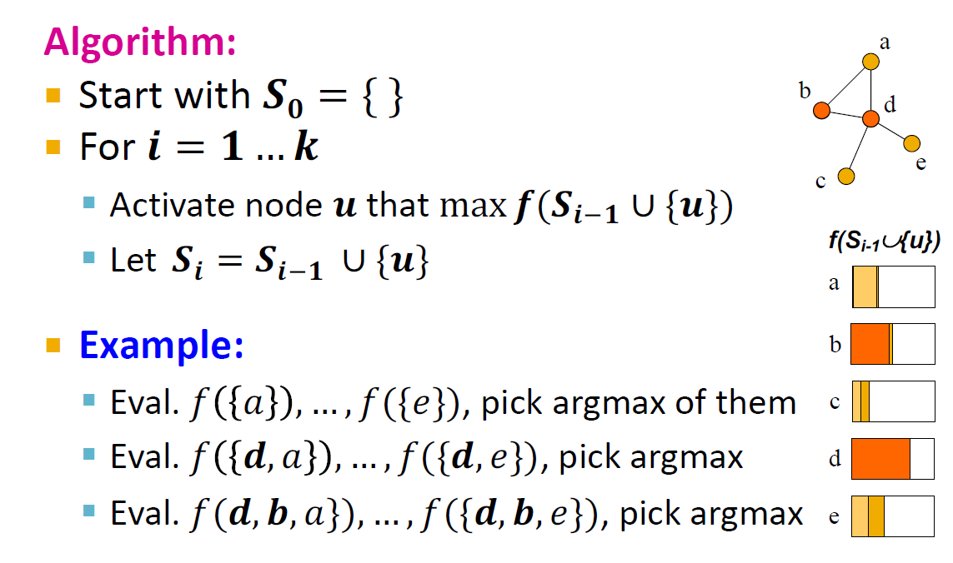
Greedy Hill Climbing

